Slide 1
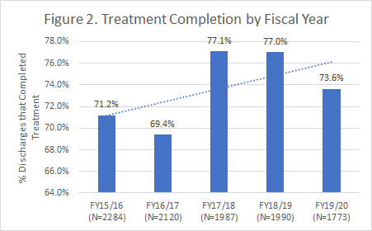
IICAPS: Connecticut’s Premier Intensive In-Home Child and Adolescent Psychiatric Services (IICAPS)
Improving Quality of Life: Children and adolescents experiencing serious emotional disturbance have and will continue to have a decrease in the utilization of psychiatric hospitalization days, fewer Emergency Department visits, fewer Psychiatric Residential Treatment Facility stays, improved functioning and decreased problem severity.
Our Approach: IICAPS is an intensive multi-generational complex trauma and attachment informed in-home treatment model. IICAPS is a level of care across CT. This means that we are offered to all families receiving Medicaid who are experiencing chronic and acute psychiatric crisis. Data has consistently shown that IICAPS families (both parents and children) struggle with histories of significant and often chronic developmental trauma which impacts parenting practices and child and family mental health.
Our Evidence Base: IICAPS considers itself Practice Based Research which refers to evidence that is collected in real world scenarios rather than tightly controlled environments. This better reflects the actual work teams do with families with multiple complex comorbidities, financial stressors, and structural inequalities. Our model is flexible and responsive to research and best practices. We use quarterly quality assurance and quality improvement data to demonstrate effectiveness and inform ongoing model development.
Who are the families who need IICAPS (2014-2019)?
How well does it work (2014-2019)?
How many times can IICAPS support and stabilize?
For all treatment completers, we see a significant reduction in Ohio scale symptom severity and improvement in Ohio scale functioning
50% of cases on average showed clinically reliable changes
Of those who complete the treatment satisfaction survey (82.3%) - 86.3% report Agree or Strongly Agree that they had a positive experience, felt the intervention improved the parent/child relationship, and that the team was respectful of their cultural/ethnic background and religious beliefs.
67% of children and adolescents report one or more experiences of complex trauma
Roughly half of IICAPS parents endorse 4+ adverse childhood experiences
Program evaluation data from 2006 -2019 demonstrates that children and families receiving a repeat episode of IICAPS continue to make gains.
The majority of IICAPS patients (82%) will require only one episode of care to maintain stability.
For those who require a second episode of care, they don’t return as acute, and they make increased gains.
The likelihood of requiring more than three episodes of IICAPS is extremely rare and is only used for youth with persistent and severe symptoms.
Story behind the data:
When compared to the state, IICAPS disproportionally serves families of minority racial/ethnic groups.
Diagnosis data is extremely variable, and many youth have multiple diagnosis.
IICAPS primarily serves youth eligible for Medicaid.
Story behind the data:
As the intervention has evolved to become more complex trauma-informed, there has been an increase in treatment completion.
For the families who discharge having successfully completed treatment, these gains have been shown to maintain 6 months after discharge.
Created 01/02/23
Page 1 of 2
Notes:
On average, caregivers in IICAPS endorsed 3.5 (sd = 2.8) adverse childhood events. These scores did deviate from normality with a median of 3 and a positive skewness of 0.49. Only 16% of caregivers reported no adverse events, while 45% reported four or more such events (see Figure 1). The most commonly endorsed ACE item was parental divorce or separation (55%). Over 40% of the caregivers in the sample endorsed experiencing emotional abuse (42%), living with someone who had a mental illness (41%), and living with someone with a substance use issue (45%). The remaining ACE items were endorsed by at least 20% of caregivers (23% to 39%), except for physical neglect, which 18% of caregivers endorsed.

Slide 2
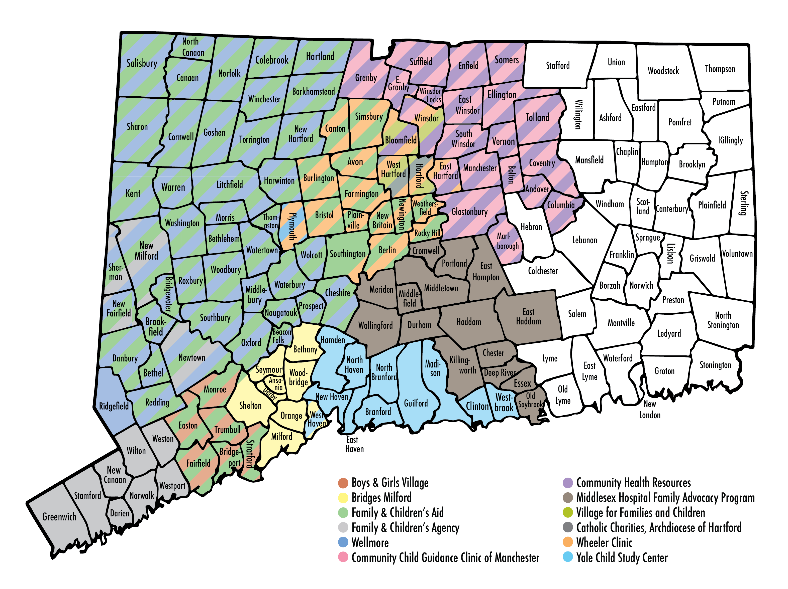
What is the overall impact?
IICAPS Network Coverage:
IICAPS In Summary:
Completion rate is high for this complex population.
Quality assurance data show clinically meaningful reductions in parent, child, and clinician rated symptom child severity and improvements in child functioning.
Home-based modality reduces barriers to accessing treatment.
Model allows time and flexibility to build trusting relationships with family members.
Model provides multi-generational complex-trauma informed psychotherapy for parents, child, and family.
Positive long-term relationship with home-based providers translates into greater institutional trust – connect to care, referrals for psychiatric evaluation, collaboration with schools, DCF, hospitals.
Significant cost-savings for the state due to reductions in service utilization.
To make this level of care sustainable we are requesting:
An additional 15% Medicaid rate increase so that agencies can cover costs and consider cost-of-living increases/inflation. We believe this will largely address workforce shortages.
Annual COLA rate increases to make this level of care sustainable.
Increased funding ($870,000.00) for IICAPS Model Development and Operations through our DCF contract to onboard new sites, ensure adequate training, clinical support, quality assurance, model development and other enhancements.
Our Partners:
IICAPS is covered by Medicaid and reimbursed on a fee-for-service basis.
IICAPS Model Development and Operations through the Yale Child Study Center, provides ongoing training, consultation, and support for 16 sites at 12 distinct agencies across the state of CT and is funded by a grant through the Department of Children and Families.
Missing coverage across the state largely due to staffing shortages and chronic underfunding.
State-wide waitlist has been at or around 500 for the past two years.
Sites that closed due to staffing shortages and/or underfunding closed with waitlists.
Revised 01/01/23
Page 2 of 2
Notes:
Boys & Girls Village Catchment Area: Greater Bridgeport area
Bridges Catchment Area: Greater Milford area and the Valley
Catholic Charities Catchment Area: Hartford
Community Child Guidance Clinic Catchment Area: Greater Manchester area
Community Health Resources Catchment Area: Greater Manchester area
Family & Children’s Agency Catchment Area: Greater Norwalk, Stamford and Greenwich areas Family & Children’s Aid Catchment Area: Greater Bridgeport area, Greater Danbury area, Greater New Britain area, Greater New Milford area, Greater Shelton area and Valley, Greater Waterbury area, Greater Torrington area and the Northwest Corner Middlesex Hospital Catchment Area: Greater Middletown area, Greater Meriden/Wallingford area, Chester, Durham, Essex and Old Saybrook Village for Families and Children: Catchment Area: Greater Hartford area Wellmore, Inc. Catchment Area: Greater Waterbury area, Greater Torrington area and Northwest Corner
Wheeler Clinic Catchment Area: Greater New Britain and Plainville area, Greater Hartford area
Yale Child Study Center Catchment Area: New Haven and Greater New Haven, Guilford, Madison, Clinton

