Slide 1
Urgent Crisis Centers
Presentation to the Transforming Children’s Behavioral Health Policy and Planning Committee
September 6, 2023

Slide 2
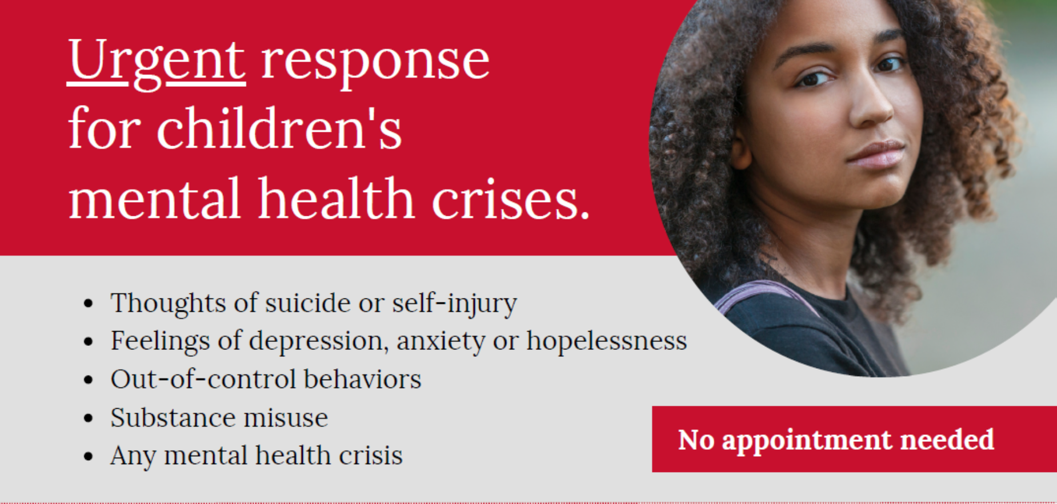

Slide 3





Slide 4
Why Urgent Crisis Centers?
Children’s Behavioral Health Plan (2014):
Recommended expanding crisis-oriented behavioral health services to address high utilization rates in emergency departments. Specifically, explore alternative options to ED's, through short-term (e.g., 23 hour) behavioral health assessment/crisis stabilization centers.
Children’s Behavioral Health Urgent Care and Crisis Stabilization Unit Workgroup (2021):
EDs are routinely overwhelmed by the numbers of patients presenting for care, resulting in overtaxed staff resources and significant wait times for patients.
A significant percentage of youth who present to an ED with a behavioral health need could be effectively assessed and treated in another setting. This is supported by the fact that these youth are not ultimately admitted to an inpatient hospital.
EDs vary regarding the behavioral health expertise of their staff, and in their familiarity with local systems of care and their ability to connect youth to ongoing community services. This can sometimes increase the chances of youth being referred for continued hospitalization.

Slide 5
Why Urgent Crisis Centers?
Short-Term Solutions to Behavioral Health ED Volume Workgroup -- Family Input (family surveys administered through family advocacy organizations and local community collaboratives):
Create alternatives to Emergency Departments for youth experiencing behavioral health needs:
  Expanding Mobile Crisis services
  Create alternate places to receive care (e.g., Urgent Crisis Center)
Improve the behavioral health care in Emergency Departments for youth who need to go there:
  Add more staff with behavioral health expertise
  Create separate space appropriate for serving children with behavioral health needs
  Improve timeliness of assessments
  Improve referral process from ED to other services
  Better communication between EDs, community-based providers, and schools

Slide 6
Why Urgent Crisis Centers?
SAMHSA National Guidelines for Behavioral Health Crisis Care – A Best Practice Toolkit:
Regional Crisis Call Hub Services:
Someone To Talk To
Mobile Crisis Team Services:
Someone To Respond
Crisis Receiving and Stabilization Services:
A Place to Go

Slide 7
UCC Catchment Region | Program Location | Included Cities | Daily Service Capacity | 12-Month Funding
North Central | Hartford | Hartford / Manchester / Meriden New Britain / Enfield | 24 | $4,200,000
Southern | New Haven | Bridgeport/ Norwalk Stamford / New Haven/ Milford | 24 | $4,200,000
Eastern | New London | New London / Willimantic Norwich / Old Saybrook | 12 | $2,600,000
Western | Waterbury | Waterbury / Danbury Torrington | 12 | $2,600,000

Slide 8
Multi-System Implementation
Department of Social Services
  Program-Specific Billing Codes and Fees
  Medicaid State Plan Amendment
Department of Public Health
  Protocols for Ambulance Transport to UCC in Consultation with Hospital Medical Staff
Department of Education
  Statewide Meeting of School Superintendents
  Statewide Special Education Conference

Slide 9
UCC Program Component | Community-Based Programs | Hospital-Based Program
Specialized Space | Yes | In Process
24/7 Availability | In Process | Yes
Walk-In Access | Yes | Yes
Emergency Services Access | In Process | Yes
Crisis Triage | Yes | Yes
Nursing Assessment | Yes | Yes
Clinician Assessment | Yes | Yes
Psychiatric Assessment | Yes | Yes
Crisis Stabilization | Yes | Yes
Youth/Family Strengths & Needs Assessment | Yes | Yes
Youth/Family Safety Planning | Yes | Yes
Connect to Care | Yes | Yes
Community Collaboration | Yes | In Process
Follow-Up Support | Yes | In Process

Slide 10

Shared Vision of Care
Informed by variety of clinical approaches used by outpatient and home-based treatment, but inclusive of solution focused, crisis intervention and trauma informed approaches
Collaborative
Inclusive
Deliberate
Innovative
Partnering
Committed

Slide 11
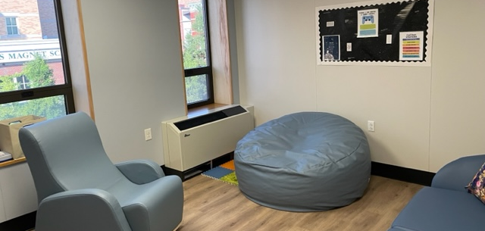
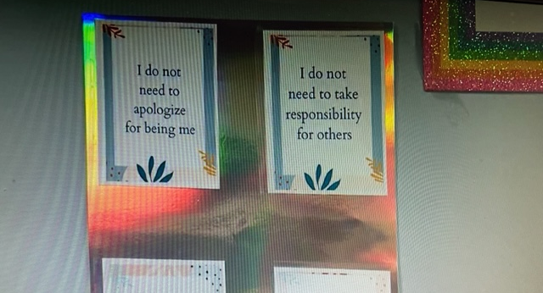
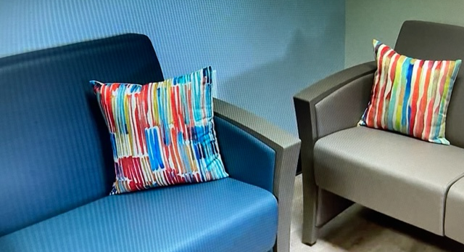
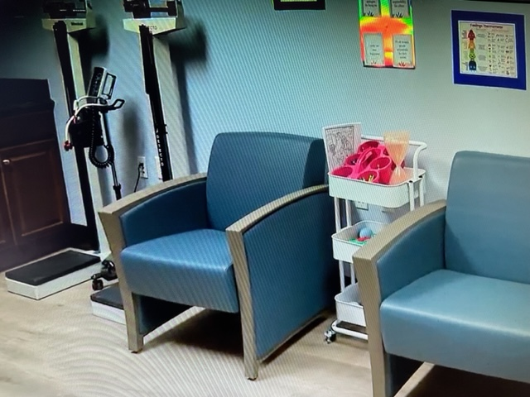
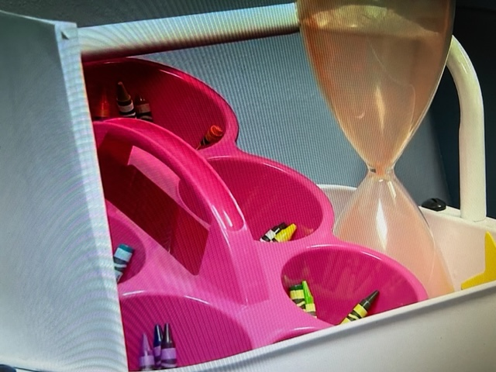
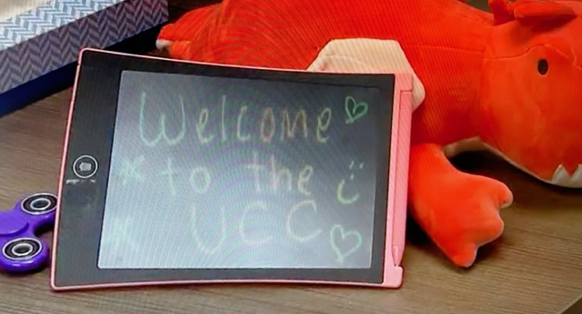

Slide 12

Youth and Families Connecting to Care

Slide 13

Hearing from the youth and families…what have they said about their experience at the UCC
Connected
Relieved
Hopeful
Calm
Trusted
Satisfied
Grateful
Safe
Motivated
Empowered
Heard

Slide 14
Making an Impact
Utilization
  How many youth & families access the services?
  From where are youth & families referred to UCCs?
  What are the presenting challenges & needs of the youth & families?
  Are there disparities or barriers to youth and families accessing the UCCs?
Youth & Family Experience of Care
  Do youth & families experience engagement, connection, and affirmation in UCCs?
  Do youth and families believe the UCCs were helpful to them?
Outcomes
  Are youth and families able to successfully stabilize and manage their crisis?
  Are youth and families able to be connected to the follow-up care they need?
Systems Issues
  What services do youth & families most often need after UCCs? Are these services available?
  Do UCCs contribute to fewer youth presenting unnecessarily to EDs?
  Do EDs experience fewer instances of overcapacity?

Slide 15
Challenges for Success
Workforce
  Shortage, diversity
Reimbursement
  No reimbursement
  Under reimbursement
  Medicaid rates
  COLA
  Private insurance vs. Medicaid available services
Connect to care
  Families cannot access care where and when needed
  Long waitlists (outpatient and in-home services)
UCCs are embedded within larger systems
  Community mental health, school, primary care offices, DCF.
  Time to demonstrate impact
  Linkage of these systems is often limited (clinically, data)
  Ambulance service

Slide 16
