Slide 1
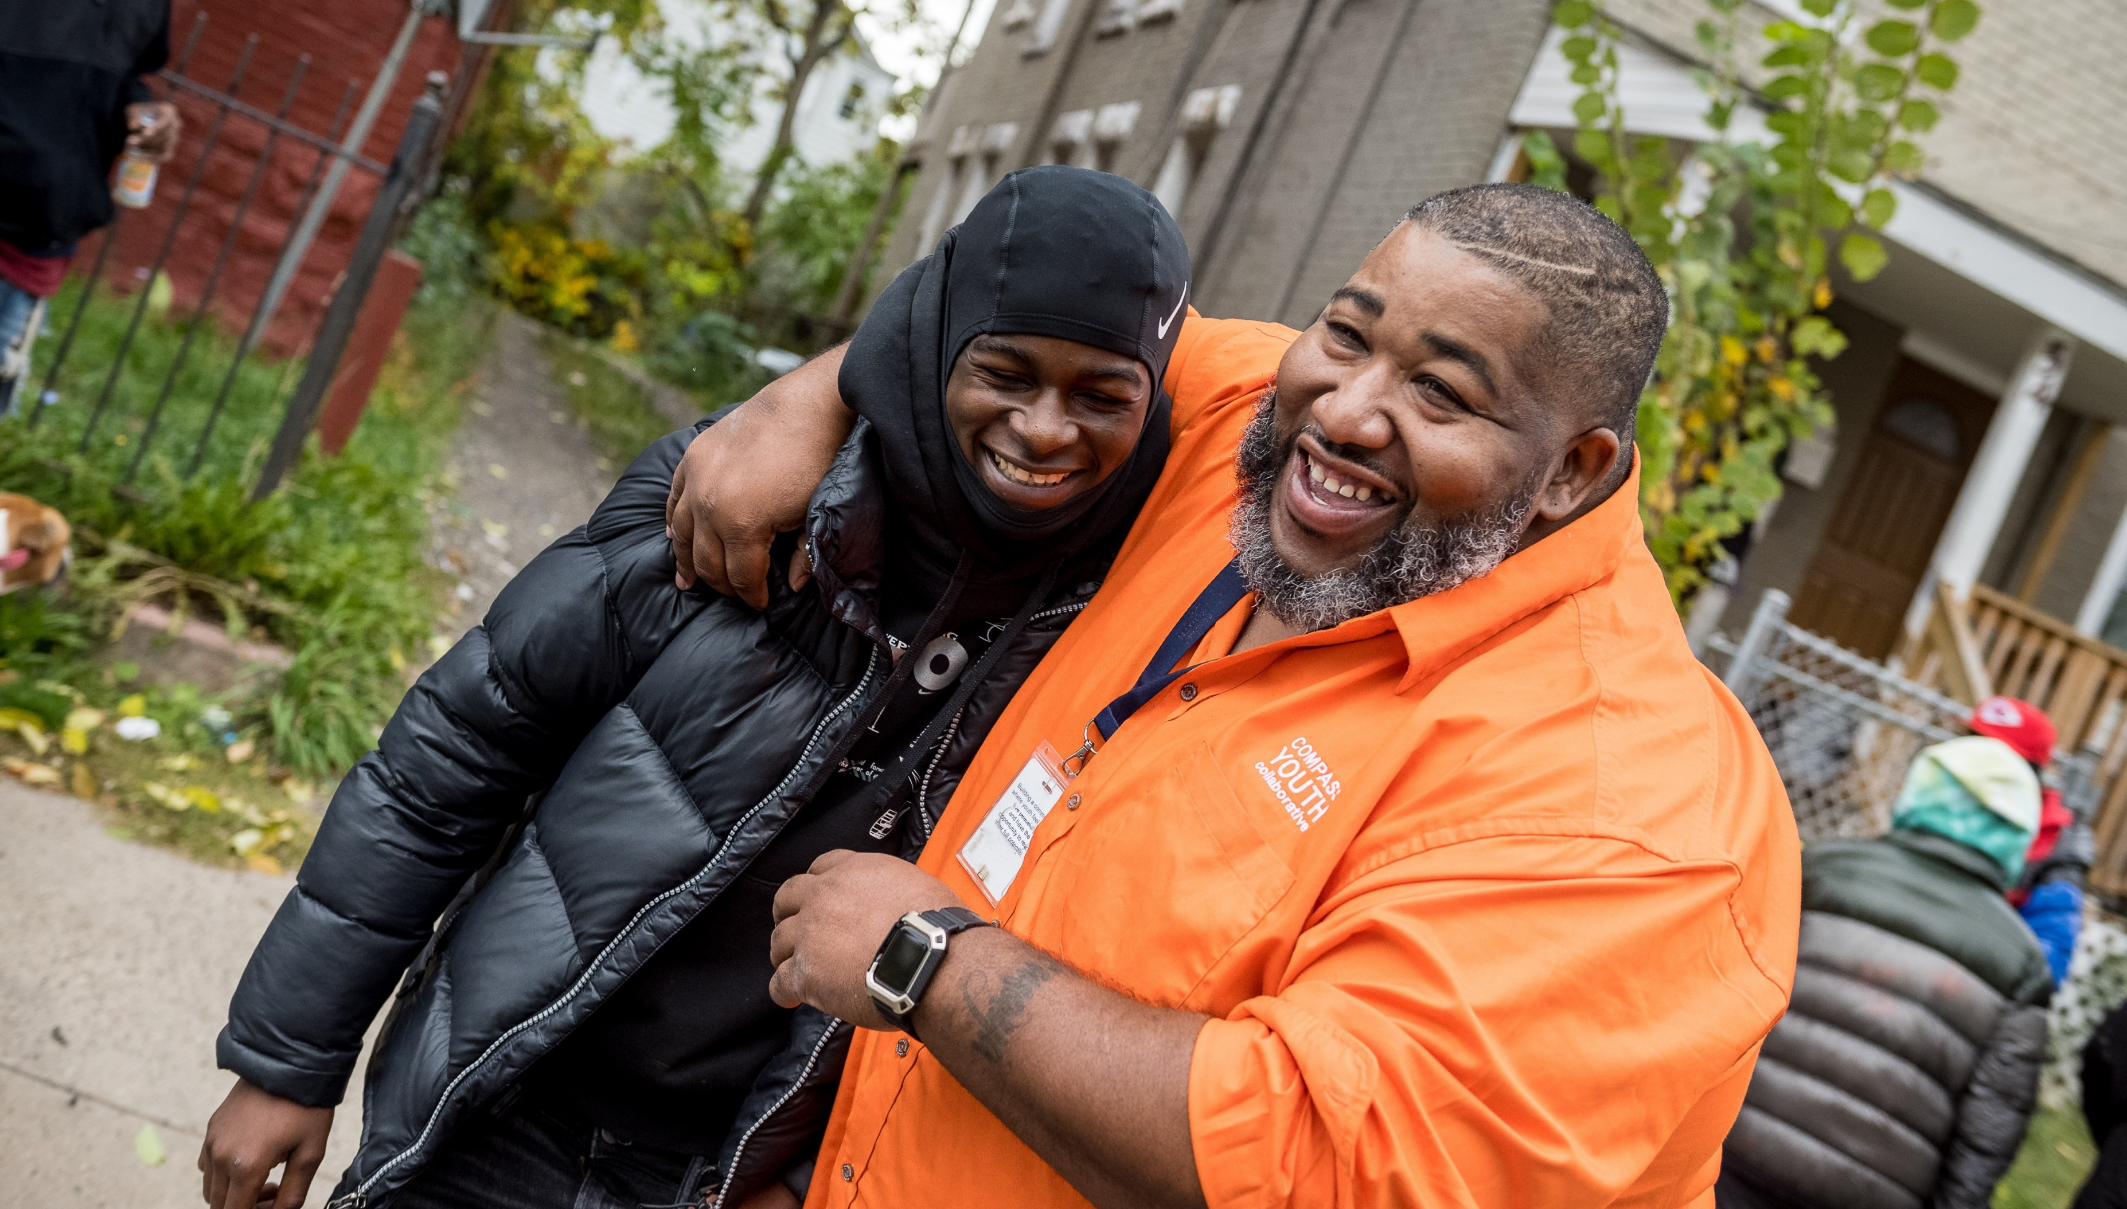

Slide 2
Traumatized Brains Develop Differently
Typical Development
Developmental Trauma
Cognition
Cognition
Social/
Emotional
Social/
Emotional
Regulation
Regulation
Survival
Survival

Slide 3
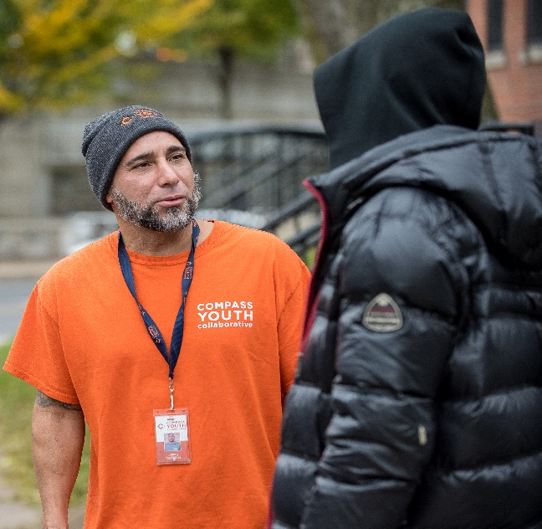
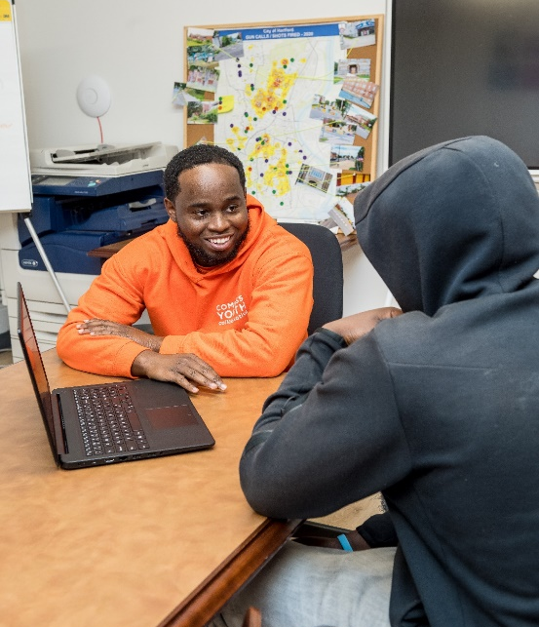
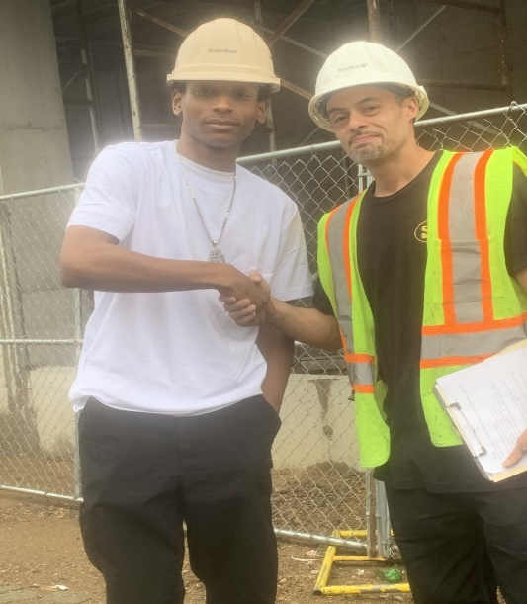
Program Overview
We imbed Cognitive Behavior Theory in all program components
Responding
to Crises and Canvassing Neighborhoods
Peacebuilders canvas the streets, connecting with young people and building trusting relationships. During times of crisis, we work in the community to deescalate the tension and build peace.
We are the only community-based violence interruption program in Hartford.
Reconnecting
Youth to Education
Our Education Specialists work with youth, reconnecting them to education, whether in traditional classrooms, earning their GED, or obtaining licensures and attending trade schools.
Connecting
Youth to Employment
Youth work with Job Specialists to provide basic employment training (professional skills, time management, self-regulation) and financial literacy education.
We give youth a safe place to fail, learn from their failure, and try again.
Supporting
Youth’s Mental Health
Using Cognitive Behavior Theory, our staff works with youth to help them understand the relationship between how they feel and what they do.
Our Licensed Clinical Social Workers and Peacebuilders provide life-saving skills, helping youth slow down, stop, and focus on what's in front of them so they can make better decisions.

Slide 4
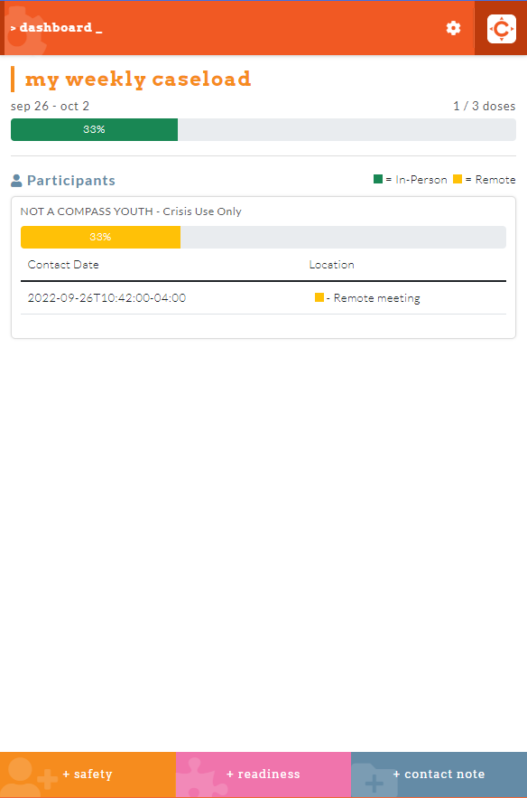
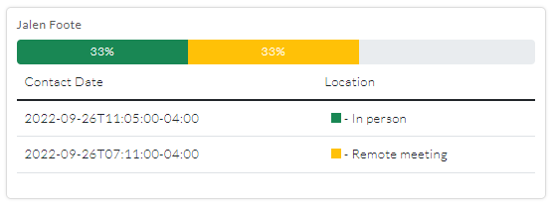
How does COMPASS collect data?
NAVI – short for Navigator – case management system
Peacebuilders enter details about each interaction with a youth into NAVI
All data is transferred in real time to update Peacebuilders on their youth’s progress
The system is kept secure, with multiple safeguards, including HIPAA compliance
PBs have recorded over 2,000 interactions per month since January
Youth 1
Youth 2
Youth 3

Slide 5
COMPASS by the Numbers
Who we serve:
At least 17% of COMPASS youth have been victims of gun violence 1 or more times
63% of participants have a known criminal justice history
67% of participants have lost a family member or friend to community violence
75% are street/gang affiliated
Results:
In the 2022-23 program year, we’ve served 237 youth in Peacebuilders
79% of our youth reduced their engagement in violence
78% made gains toward educational attainment
76% made gains toward sustained employment

Slide 6
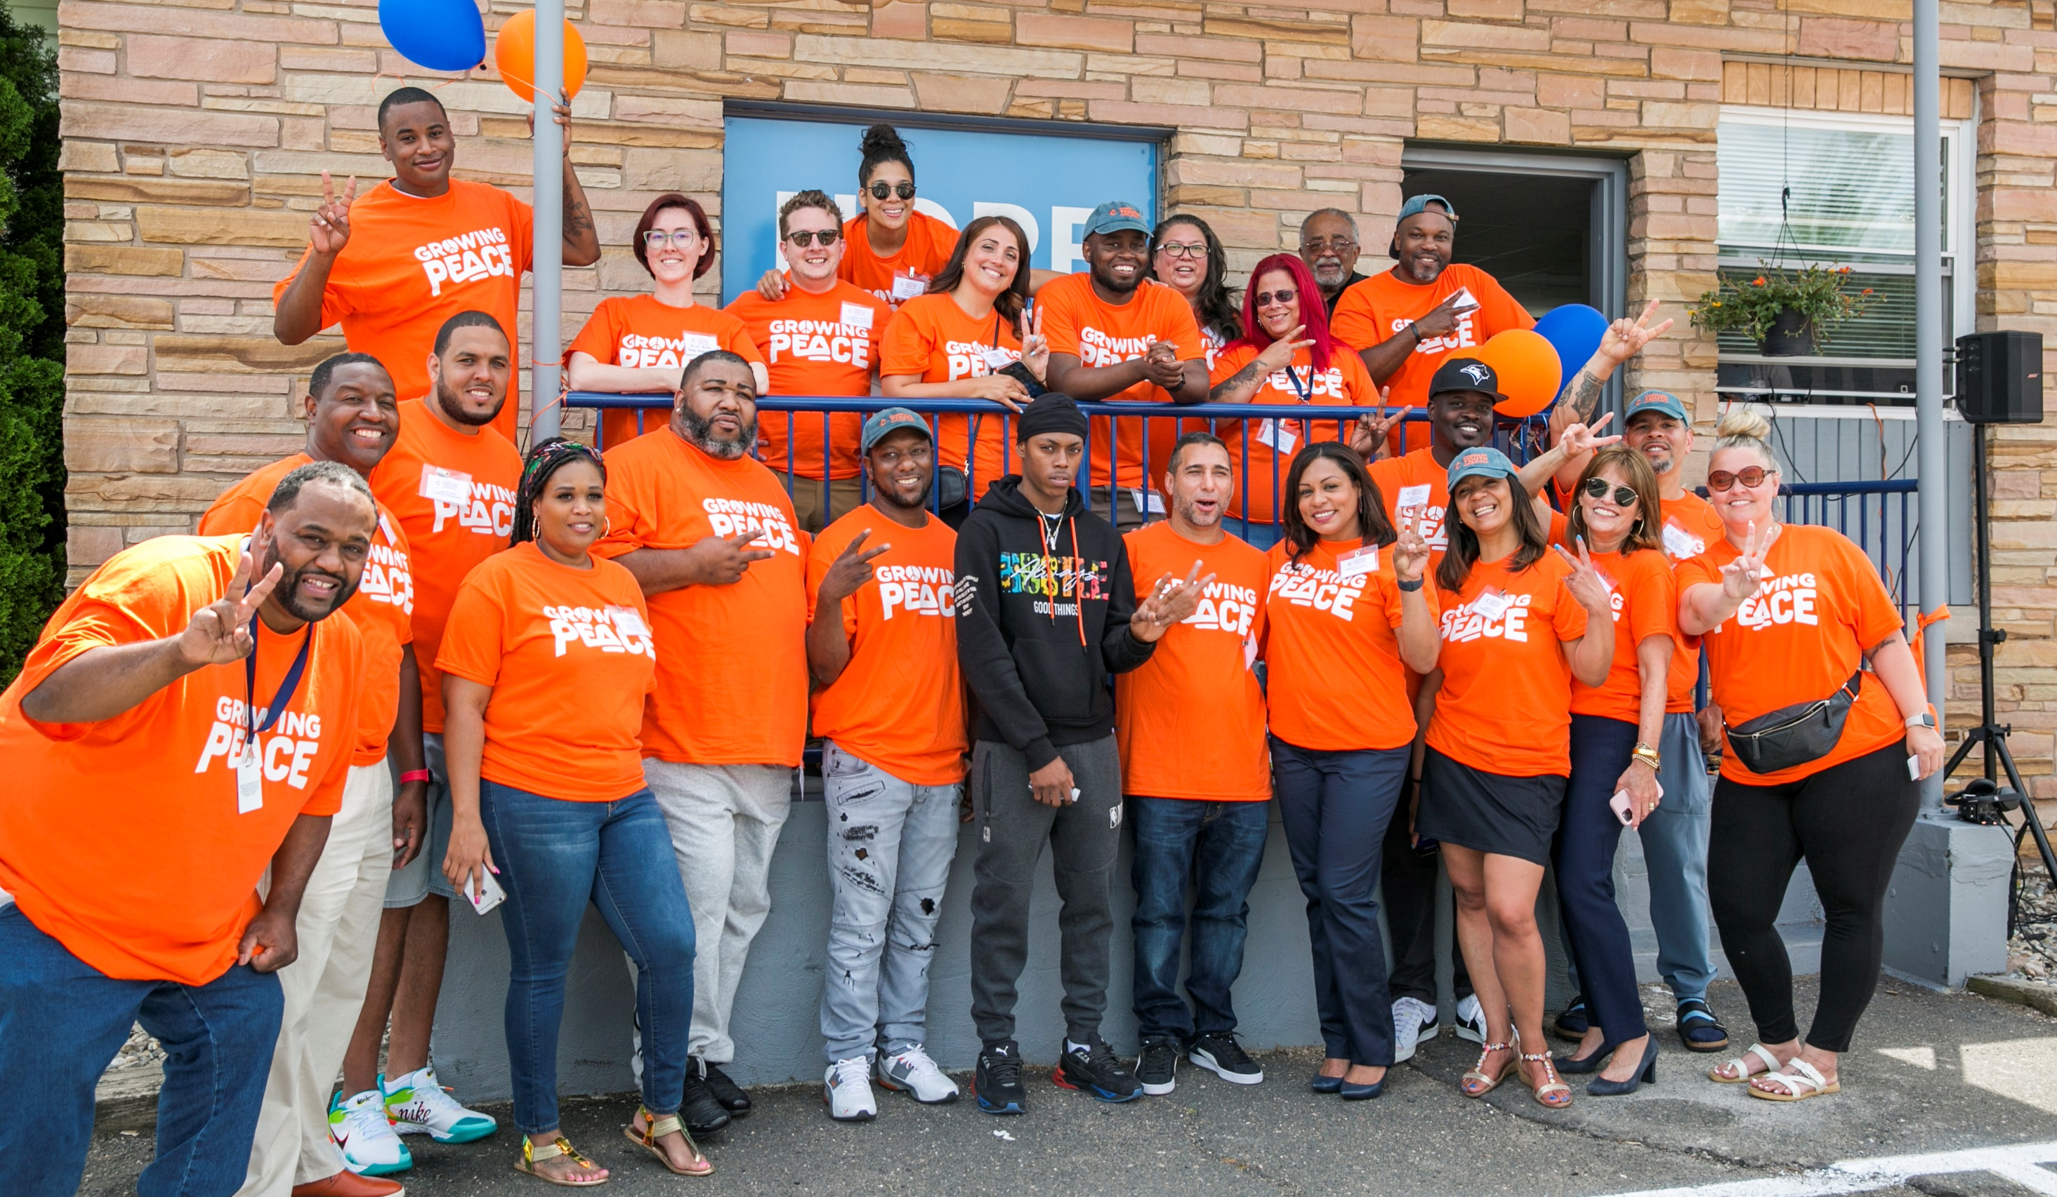
Contact Information
Jacquelyn Santiago Nazario – CEO
Santiago.Jackie@compassyc.org

Slide 7
