Slide 1
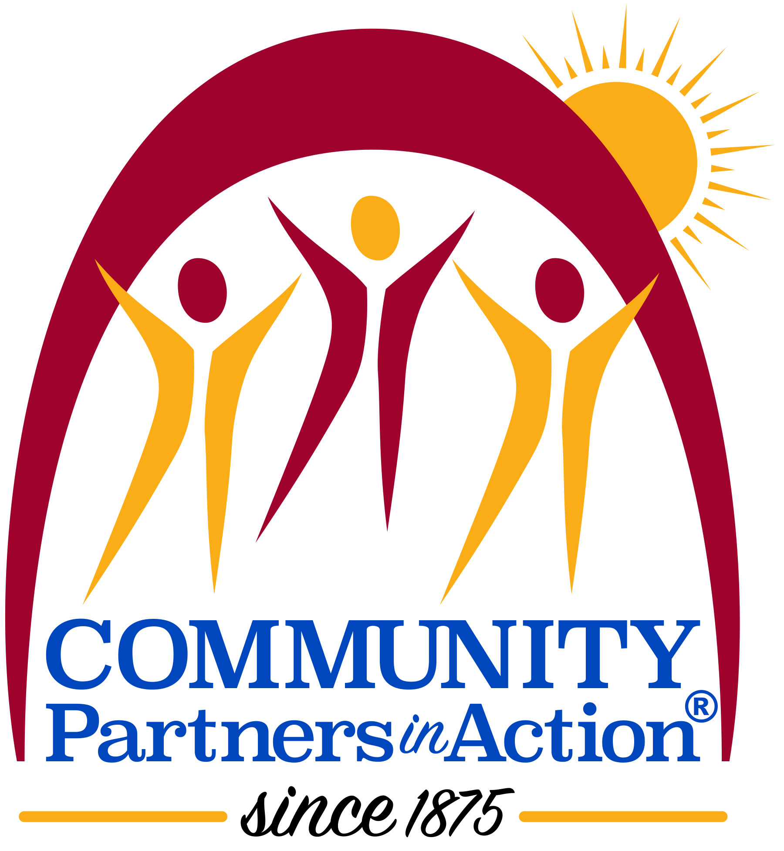

Slide 2
MISION and Guiding Beliefs
Community Partners in Action, established in 1875, is a non-profit agency building community by providing services that promote accountability, dignity, and restoration for people affected by the criminal justice system.
We believe . . .
People can change;
Prevention and intervention are preferable;
Program decisions must be knowledge-based;
Community groups and citizen volunteers are crucial partners with us in this work;
Mutual respect must mark all our relationships.

Slide 3
CPA’s Commitment
One of the oldest organizations of its kind in the country, Community Partners in Action (CPA) was founded nearly 150 years ago to champion criminal justice reform and advocate for preserving the dignity of those in and out of prison. Through our programs that include reentry and housing, youth initiatives, a nationally recognized Prison Arts Program, and holistic alternatives to incarceration, we provide a long-term impact that positively transforms individuals and society at large. Annually serving nearly 7,000 individuals throughout Connecticut, our work is possible due to partnerships with and support from individuals, government, private funders, organizations, and businesses.
CPA’s commitment to ensuring our participants, the majority of whom are people of color, have the right to work; the right to an adequate standard of living including food, clothing, and housing; the right to physical and mental health services; the right to a healthy environment and the right to education has never wavered since our incorporation in 1875. The equality we fight for on behalf of our participants extends to our dedicated staff as well.

Slide 4
CPA Programming At A Glance
Alternative in the Community (AIC)
Transitional Housing (Waterbury and Hartford- Male)
Greater Hartford Reentry Welcome Center (GH-RWC)
Waterbury Reentry Welcome Center (WRWC)
Community Service at Hartford Community Court (HCC)
Work Release Program (WRP)
Prison Arts Program
REGIONS Site Secure Residential Program for Male Youth (Hamden)
REGIONS Staff Secure Residential Program for Male Youth (Hartford)
Early Screening Intervention Units (Hartford and Waterbury)
Juvenile Detention Enrichment Program (Hartford and Bridgeport)
Mart’s House (Transitional House-Female)

Slide 5
Alternative in the Community – AIC
Locations: Hartford (1986); Manchester (1988); and Waterbury (2011)
Participants include people on probation or parole or those with a pending criminal case
Services include:
Risk and Needs Assessments – Level of Service Inventory Revised
Reasoning and Rehabilitation II - Revised (R & R II - R) for Men
Treating All Dependencies (TAD) for Men and Women
Building Resilience for Men
Employment and Job Development for Men and Women
Moving On for Women
Living Safely Without Violence for Women
Strategic Case Management for Men and Women
Referrals to Community Resources and Follow up for Men and Women

Slide 6
Transitional Housing
The Transitional Housing Program accepts male participants 18 years of age and older;
Two facilities – one in Hartford with 33 beds and one in Waterbury with 29 beds;
Program serves males on probation and/or in pre-trial status;
All of the participants referred to Transitional Housing are required to participate in programming offered by the AIC (case management and interventions just described).

Slide 7
The Greater Hartford and Waterbury Reentry Welcome Centers
The Centers offer a centralized hub of services for individuals who find themselves involved in the criminal justice system.
The Cities of Hartford and Waterbury are strategic partners in this work and there are over 40 community partners in both cities providing essential wrap-around services.
The Centers are a place where individuals returning home from incarceration feel welcome and receive the support they need to successfully transition home.
The Centers provide:
On-site, trained staff to assess immediate needs and provide case management
Connect and refer individuals to support services which include:
Basic needs
Securing identification
Housing support
Recovery & harm reduction
Mental and physical healthcare
Training and employment
Support groups
Computer Access

Slide 8
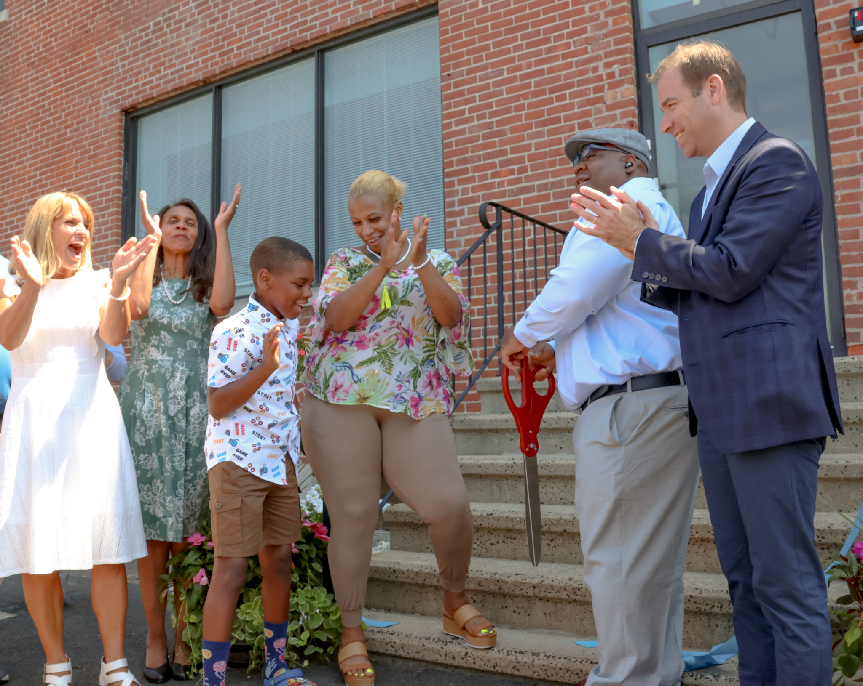
Photo of the GH-RWC Ribbon Cutting Ceremony to mark its official opening!

Slide 9
Community Service at Hartford Community Court
Participants of our Community Service program at Hartford Community Court are assigned to projects which enable them to give back to the community while fulfilling their mandated service requirements.
Projects include state agencies, partnerships with the Cities of Hartford and West Hartford, faith-based organizations, food pantries, shelters, parks and farms, healthcare providers, and nonprofit organizations.
Community service helps to hold participants accountable for their actions by performing meaningful community service projects to repair the harm caused by their actions (Restorative Justice)
The Justice Garden at Hartford Community Court: The garden contains vegetable markers displaying themes of “Hope, Love, Voice, Neutral, Equality, and Fairness.”
Clothing Closet: Community Court also maintains a closet that provides access to clothing, undergarments, shoes, and outerwear for participants, people coming to the Court seeking assistance, Hartford residents, and others in need.
Care Packages: Community Service participants compile and distribute the packages, filled with items that address a person’s immediate basic needs (socks, gloves, hats, snacks, hand sanitizers, toiletries, disposable washcloths, foot warmers, emergency thermal blankets, etc).

Slide 10
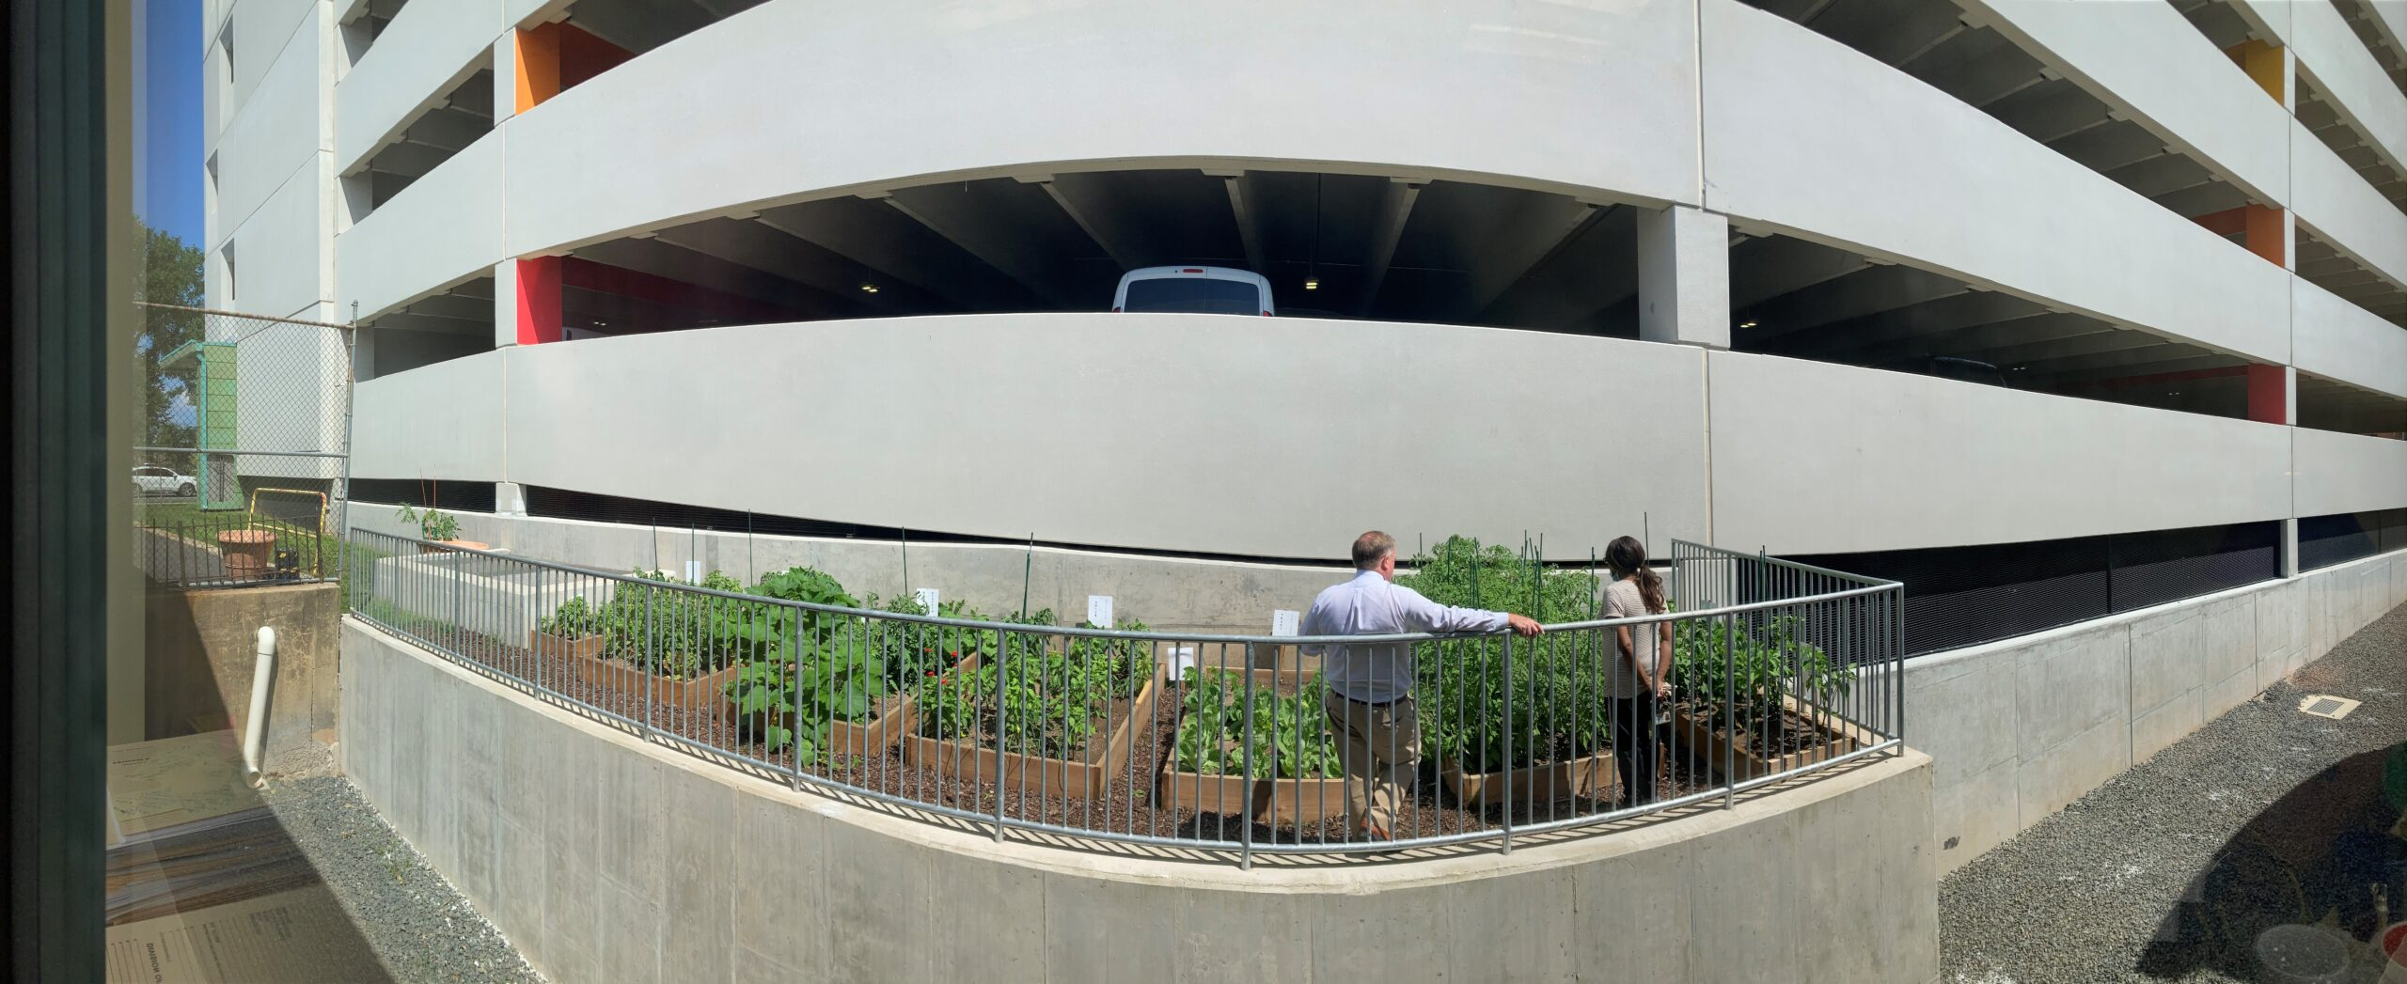
Hartford Community Court – The Justice Community Garden

Slide 11
Work Release Program (WRP): Est. 1995
24 beds; 90-120 day program;
A residential program for men on parole completing the last part of their prison sentence;
Transitional housing, employment assistance, financial education, basic needs support;
Men are assessed using the Ohio Risk Assessment System (ORAS) – in CT this is known as SCORES, which is another risk-need assessment;
Strategic Case Management services;
Each participant pays rent and manages their income, which helps them understand basic finances and budgeting in preparation for their release home.

Slide 12
Prison Arts Program: Est. 1978
CPA’s longest running program!
Works inside CT prisons and on the outside as individuals return to the community.
Positively & constructively changes the lives of people who are incarcerated and the prison environment by encouraging:
Creativity
Self-discipline
Work ethic
Self-esteem
Technical and communication skills
Introspection

Slide 14
REGIONS Programs for Youth
(Hamden Secure and Hartford Staff Secure)
Residential treatment for boys ages 14 to 18;
Provides a home-like setting that integrates concepts of Dialectical Behavior Therapy into culturally diverse services;
Goal is to use a therapeutic approach to reducing the youths’ risk factors and prevent them from transitioning into the adult justice system;
Staff help youth develop a positive self-image and coping skills;
Family in the youth’s life are actively involved;
Services include:
In-program school
Vocational Training
Physical fitness
Enrichment Projects
Mental Health & Medical Care

Slide 15
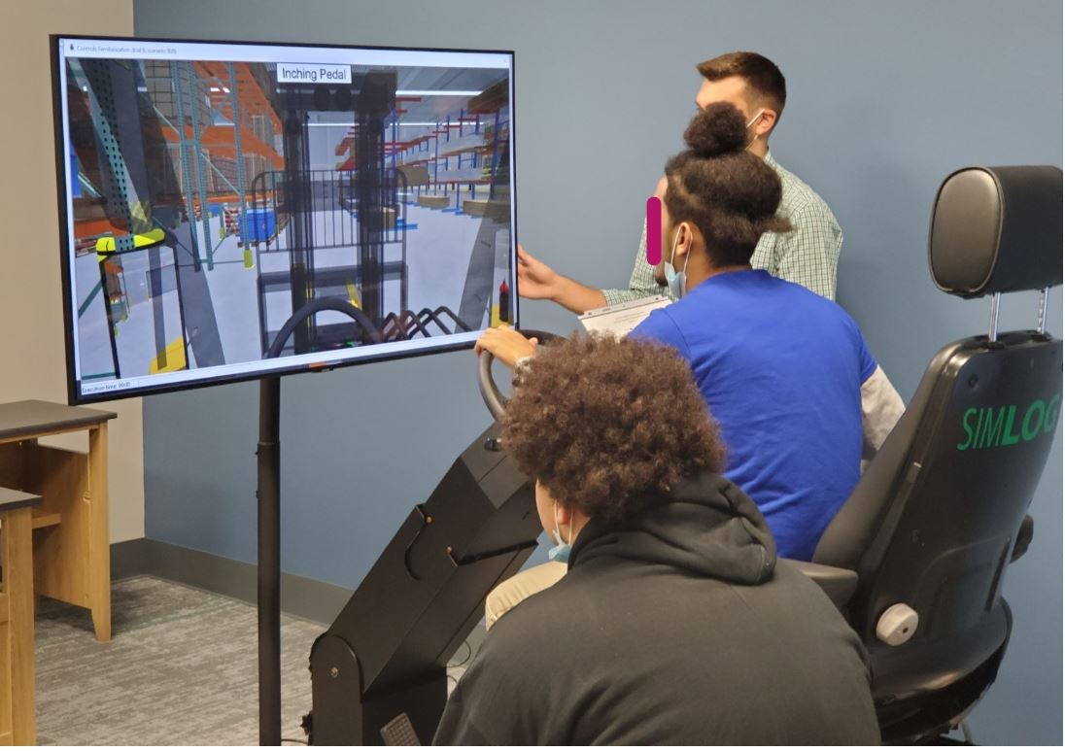
Youth at Hamden REGIONS Secure learning the Forklift Simulator

Slide 16
Early Screening and Intervention Units
Locations: Hartford Community Court and Waterbury Court;
CPA was one of the organizations that originally piloted these Units together with the Connecticut Division of Criminal Justice before it was implemented in multiple courts across Connecticut.
The Units work with people appearing in Court for low-level crimes to identify the person’s underlying causes for their criminal activities and secure the community resources needed to address them.
Program works closely with prosecutors to integrate this information with their recommendations to the judge. This allows a person to get the help needed that will likely reduce their future contact with the criminal justice system.

Slide 17
Enrichment Program for Youth: Est. 2021
Locations: Hartford and Bridgeport State Detention Centers;
Program provides youth ages 12-18 with an outlet for physical and emotional expression, encourages positive social skills, and creates an opportunity to work with other youth and staff in a different and positive manner.
Services include: Art, Music, Yoga, Dance, Pet Therapy, Life Skills, and Martial Arts.
The youth benefit by developing coping skills and experiencing healthy interactions that can continue after their release from detention.
Goal is to help these young people redirect their energies in positive ways, giving them tools they need to succeed.

Slide 18
Mart’s House-Est. 2008
Mart’s House is a warm, inviting 6-bedroom home in Manchester, CT, that is provided as transitional housing to support stable, sober living for women as they transition from prison or a shelter to their own place to live.
Mart’s House has a full kitchen, a comfortable living room, a large front porch, and a back yard. Each woman has her own bedroom and works with other residents to keep the house clean. The comfort and safety of a stable living environment helps the women as they work towards living independently.

Slide 19
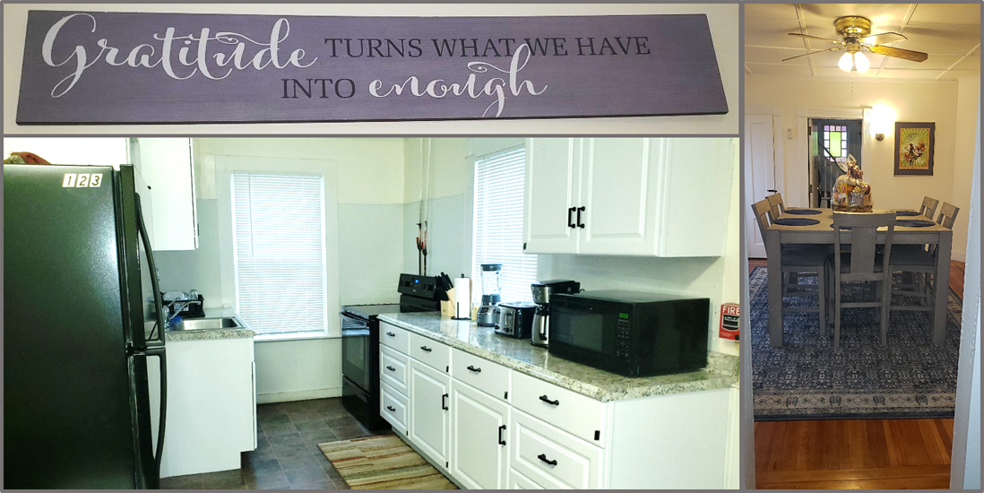
Mart’s House

Slide 20
Belonging, Equity, Diversity and Inclusion Journey - BEDI
Our BEDI Journey began in June 2020.
Led by a task force that includes board members, our executive leadership team, program managers and staff who act as BEDI Ambassadors from each of our programs.
Committed to building and maintaining an inclusive, equitable workplace.
Compelled to have a constructive impact on criminal justice reform in CT that ends racial inequities and ensures the humanity and dignity of those interacting with the system.
Our Goal: To move from an organization that is culturally diverse to one that actively identifies and removes unconscious racist and bias practices that may be embedded in our policies and infrastructure.
We work in a system that is rooted in white supremacy, systemic racism, implicit bias and exclusion – the criminal justice system – CPA is committed to leading the change towards a criminal justice system that serves all equally.
Committed to transparency throughout our mission critical BEDI Journey.

